Slide 1
Never Give Up Learning Directed Exploration Strategies Accepted in ICLR 2020
Kyeong Ryeol, Go
M.S. Candidate of OSI Lab

Slide 2
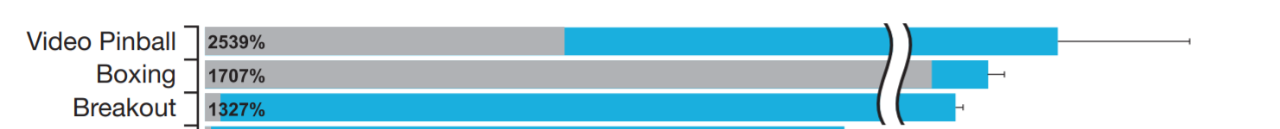
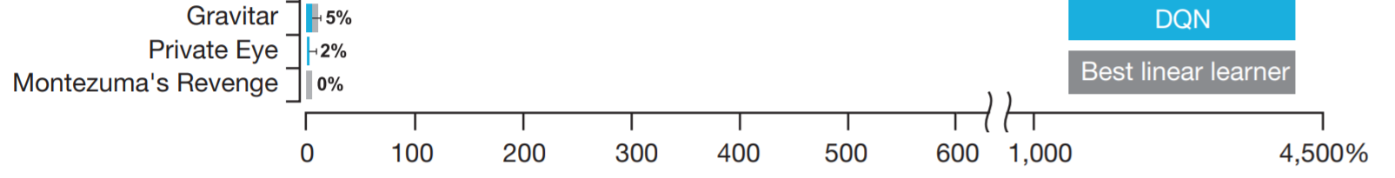
Overview
Motivation
In sparse reward setting, exploration strategy is crucial
...

Slide 3
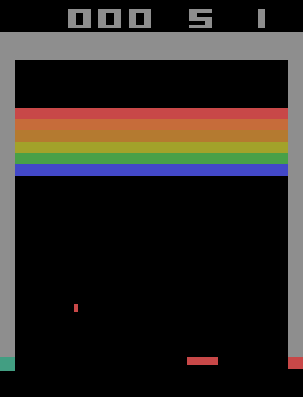
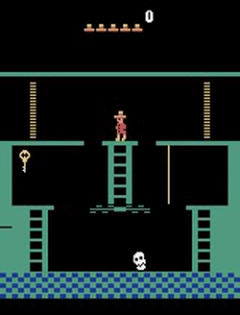
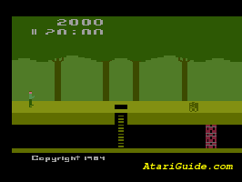
Overview
Break out
Montezuma’s revenge
Pitfalls!

Slide 4
Overview
Intrinsic reward
Quantifies the novelty of the experience to respond to agent’s curiousity
Previous work
Visitation counts : ignore the downstream learning opportunity
Prediction error : expensive, error prone, generalization issue
Main idea
Designing the intrinsic rewards to encourage the agents to visit diverse states within and across episodes
Learn a range of policies with varying the exploration and exploitation trade-offs

Slide 5
Contents
1. Never Give Up Intrinsic reward
2. Model architecture & Loss function
3. Experiment
4. Conclusion
5. Appendix

Slide 6
Never Give Up Intrinsic reward

Slide 7
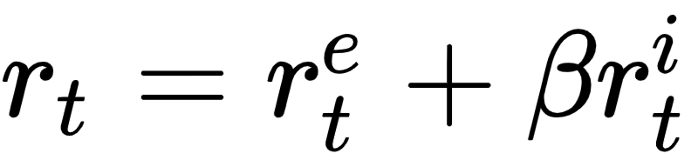
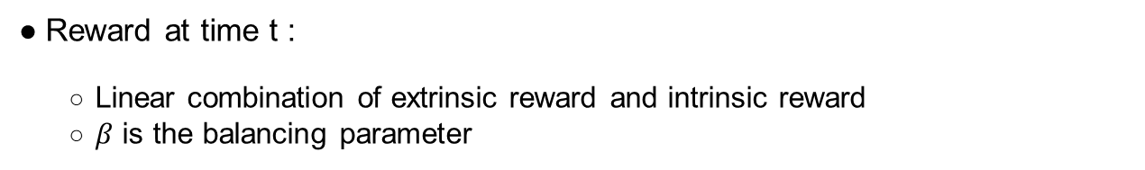
NGU Intrinsic Reward
Reward at time t :
Linear combination of extrinsic reward and intrinsic reward
$β$ is the balancing parameter
3 Properties of intrinsic reward
The notion of state ignores aspects of an environment that are not influenced by an agent.
(Embedding function)
It rapidly discourages revisiting the same state within the same episode.
(Episodic Novelty Module)
It slowly discourages visiting to states where visited many times across episodes.
(Life-long Novelty Module)

Slide 8

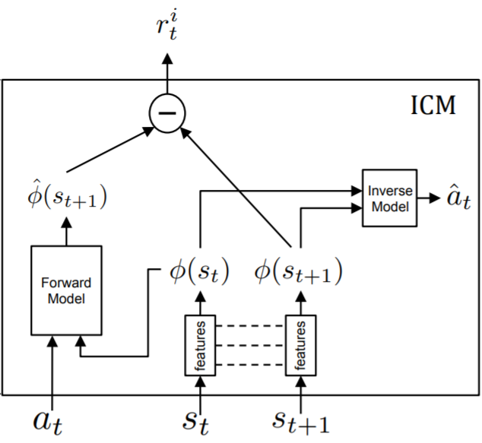
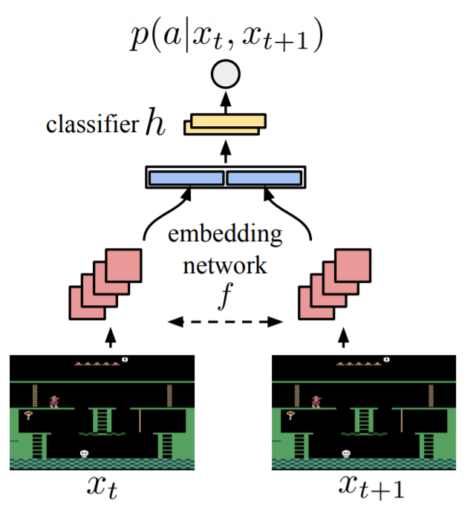
NGU Intrinsic Reward - Embedding function
Embedding function
The notion of state ignores aspects of an environment that are not influenced by an agent.
Input : two consecutive observations
Output : In-between action
Robust to inherent stochasticity
Intrinsic Curiosity Module (ICM)

Slide 9

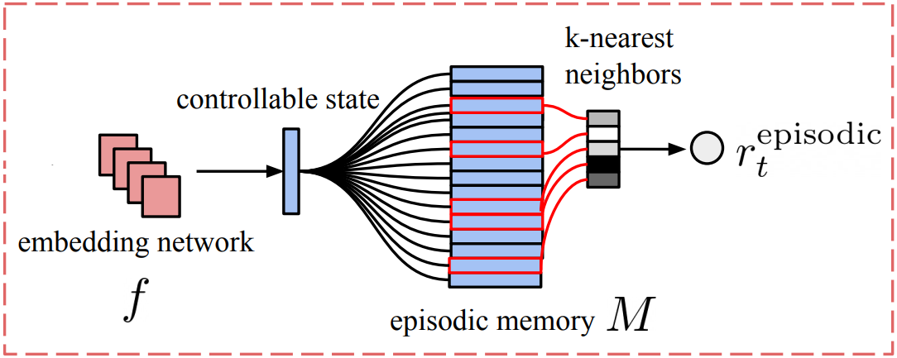
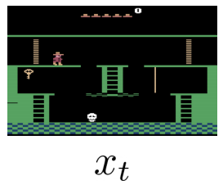
NGU Intrinsic reward - Episodic novelty module
Episodic novelty module
It rapidly discourages revisiting the same state within the same episode.
Embedding function

Slide 10
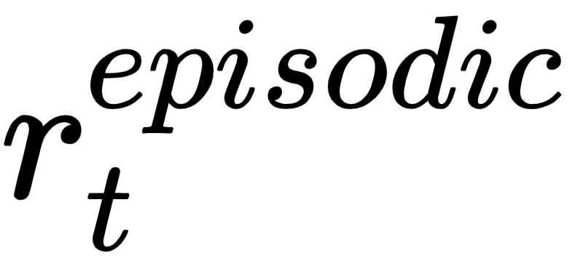
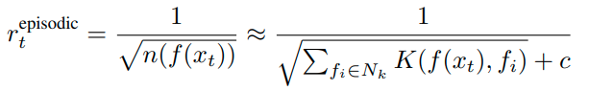
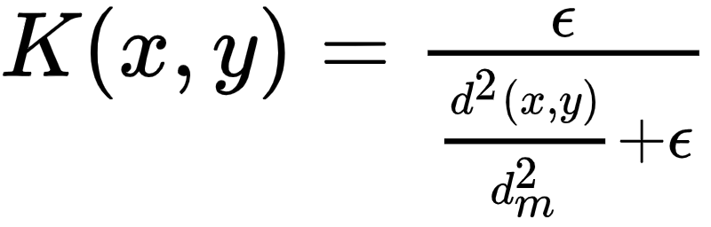
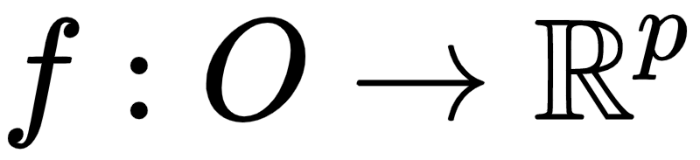
NGU Intrinsic reward - Episodic novelty module
Episodic novelty module
Episodic memory M : At every step, agent computes an episodic intrinsic reward and appends the controllable state corresponding to the current observation to the memory M
embedding function : mapping the current observation to a p-dimensional vector corresponding to its controllable state
episodic novelty : Promotes the agent to visit as many different states as possible within a single episode
From UCB

Slide 11

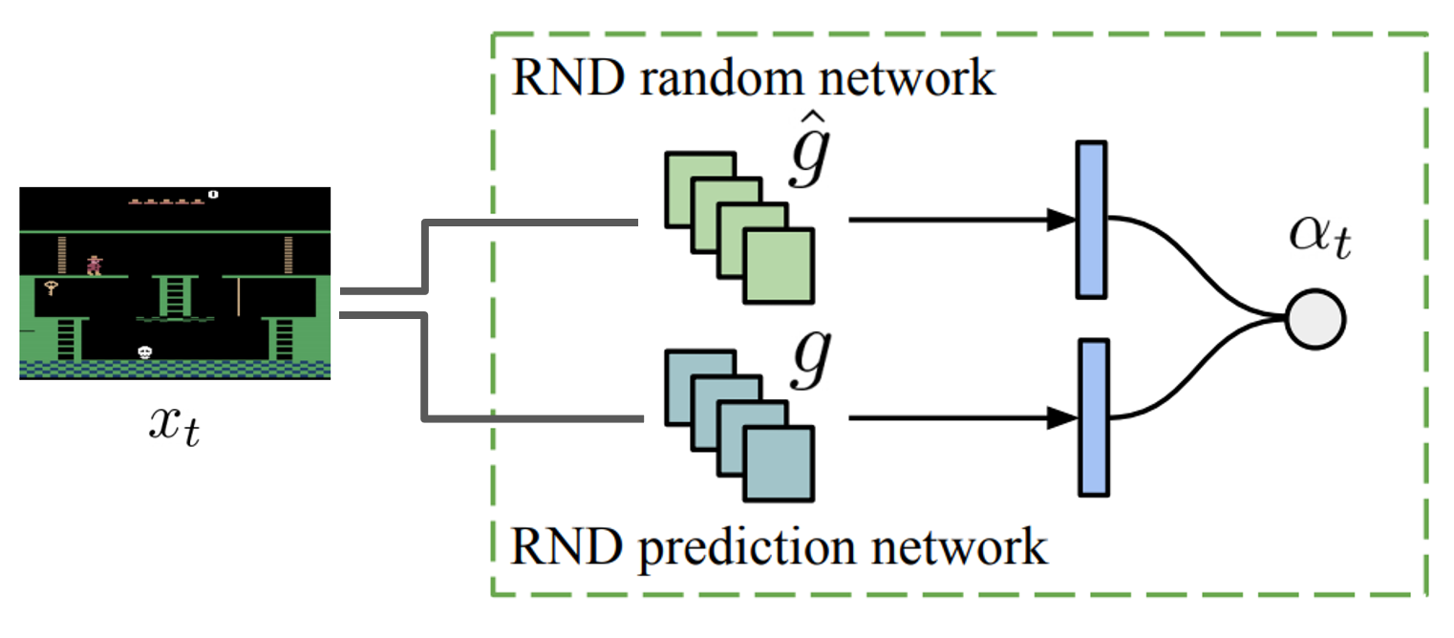
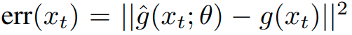
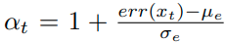
NGU Intrinsic Reward - Life-long novelty module
Life-long novelty module
It slowly discourages visiting to states where visited many times across episodes.
SOTA for Montezuma’s revenge at the time
Error would be small if similar experience to the current one would have been accumulated

Slide 12
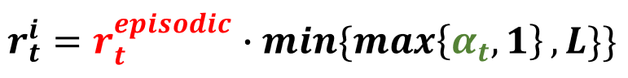
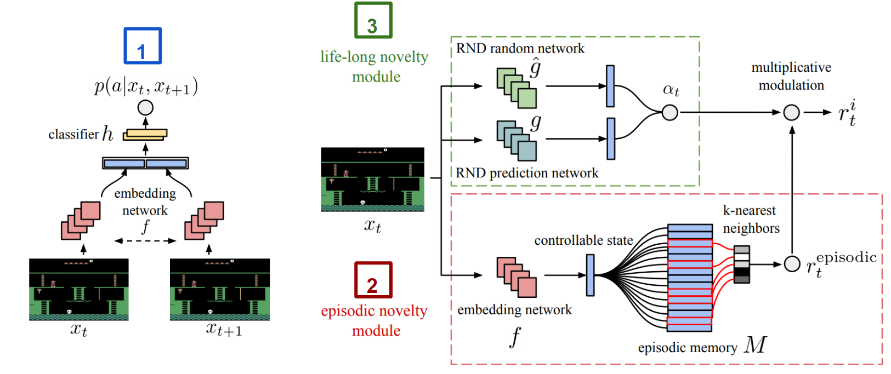
NGU Intrinsic Reward
Intrinsic reward
Episodic intrinsic reward is modulated by Life-long Intrinsic reward

Slide 13
Model architecture & Loss function

Slide 14
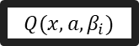

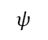

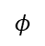
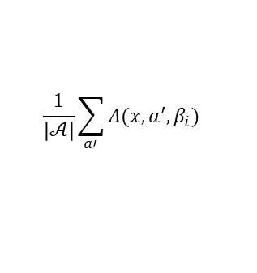
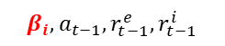
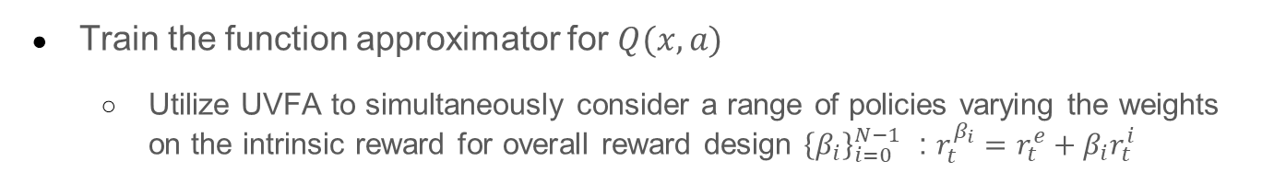
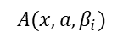
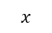
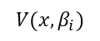
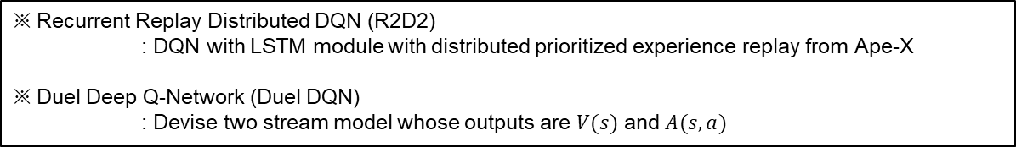
NGU - Proposed architecture
Train the function approximator for $Q(x,a)$
Utilize UVFA to simultaneously consider a range of policies varying the weights on the intrinsic reward for overall reward design ${\left\{β_{i}\right\}}_{i=0}^{N−1}$ : $r_{t}^{β_{i}}=r_{t}^{e}+β_{i}r_{t}^{i}$
※ Recurrent Replay Distributed DQN (R2D2)
: DQN with LSTM module with distributed prioritized experience replay from Ape-X
※ Duel Deep Q-Network (Duel DQN)
: Devise two stream model whose outputs are $V(s)$ and $A(s,a)$
Duel DQN
$$x$$
$$φ$$
R2D2
$$V(x, β_{i})$$
$$+$$
$$Q(x,a,β_{i})$$
LSTM
UVFA
$$−$$
$$β_{i}, a_{t−1}, r_{t−1}^{e},r_{t−1}^{i}$$
$$ψ$$
$$A(x, a, β_{i})$$
$$\frac{1}{\left|𝒜\right|}\sum_{a′}{A(x, a^{′}, β_{i})}$$

Slide 15
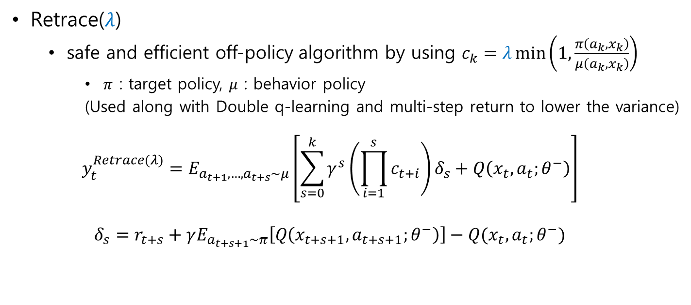
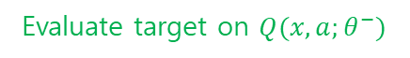
NGU - RL Loss function (1)
Retrace($λ$)
safe and efficient off-policy algorithm by using $c_{k}=λ\min\left(1, \frac{π\left(a_{k}, x_{k}\right)}{μ\left(a_{k}, x_{k}\right)}\right)$
$π$ : target policy, $μ$ : behavior policy
(Used along with Double q-learning and multi-step return to lower the variance)
$$y_{t}^{Retrace(λ)}=E_{a_{t+1},…,a_{t+s}\sim μ}\left[\sum_{s=0}^{k}{γ^{s}\left(\prod_{i=1}^{s}{c_{t+i}}\right)δ_{s}}+Q\left(x_{t},a_{t};θ^{−}\right)\right]$$
$$δ_{s}=r_{t+s}+γE_{a_{t+s+1}\sim π}\left[Q\left(x_{t+s+1},a_{t+s+1};θ^{−}\right)\right]−Q(x_{t},a_{t};θ^{−})$$
Arbitrary behavior policy is fine
Select action increasingly greedy w.r.t. $Q(x,a;θ)$
Evaluate target on $Q(x,a;θ^{−})$

Slide 16
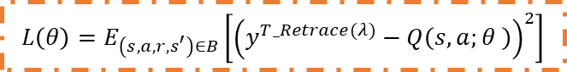
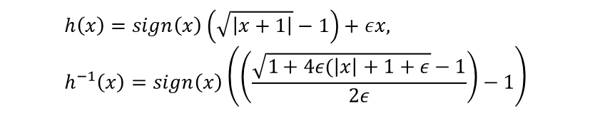
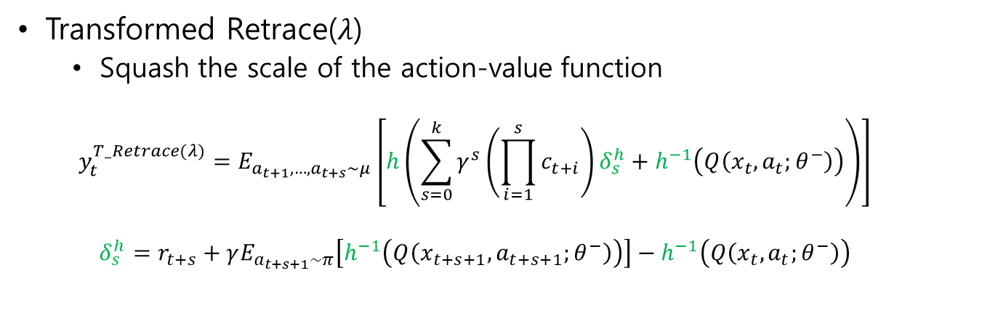
NGU - RL Loss function (2)
Transformed Retrace($λ$)
Squash the scale of the action-value function
$$y_{t}^{T_Retrace(λ)}=E_{a_{t+1},…,a_{t+s}\sim μ}\left[h\left(\sum_{s=0}^{k}{γ^{s}\left(\prod_{i=1}^{s}{c_{t+i}}\right)δ_{s}^{h}}+h^{−1}\left(Q\left(x_{t},a_{t};θ^{−}\right)\right)\right)\right]$$
$$δ_{s}^{h}=r_{t+s}+γE_{a_{t+s+1}\sim π}\left[h^{−1}\left(Q\left(x_{t+s+1},a_{t+s+1};θ^{−}\right)\right)\right]−h^{−1}\left(Q\left(x_{t},a_{t};θ^{−}\right)\right)$$
$$h\left(x\right)=sign\left(x\right)\left(\sqrt{\left|x+1\right|}−1\right)+εx, h^{−1}\left(x\right)=sign\left(x\right)\left(\left(\frac{\sqrt{1+4ε(\left|x\right|+1+ε}−1}{2ε}\right)−1\right)$$
$$L\left(θ\right)=E_{\left(s,a,r,s^{′}\right)∈B}\left[{\left(y^{T_Retrace(λ)}−Q\left(s,a;θ \right)\right)}^{2}\right]$$

Slide 17
Experiment

Slide 18
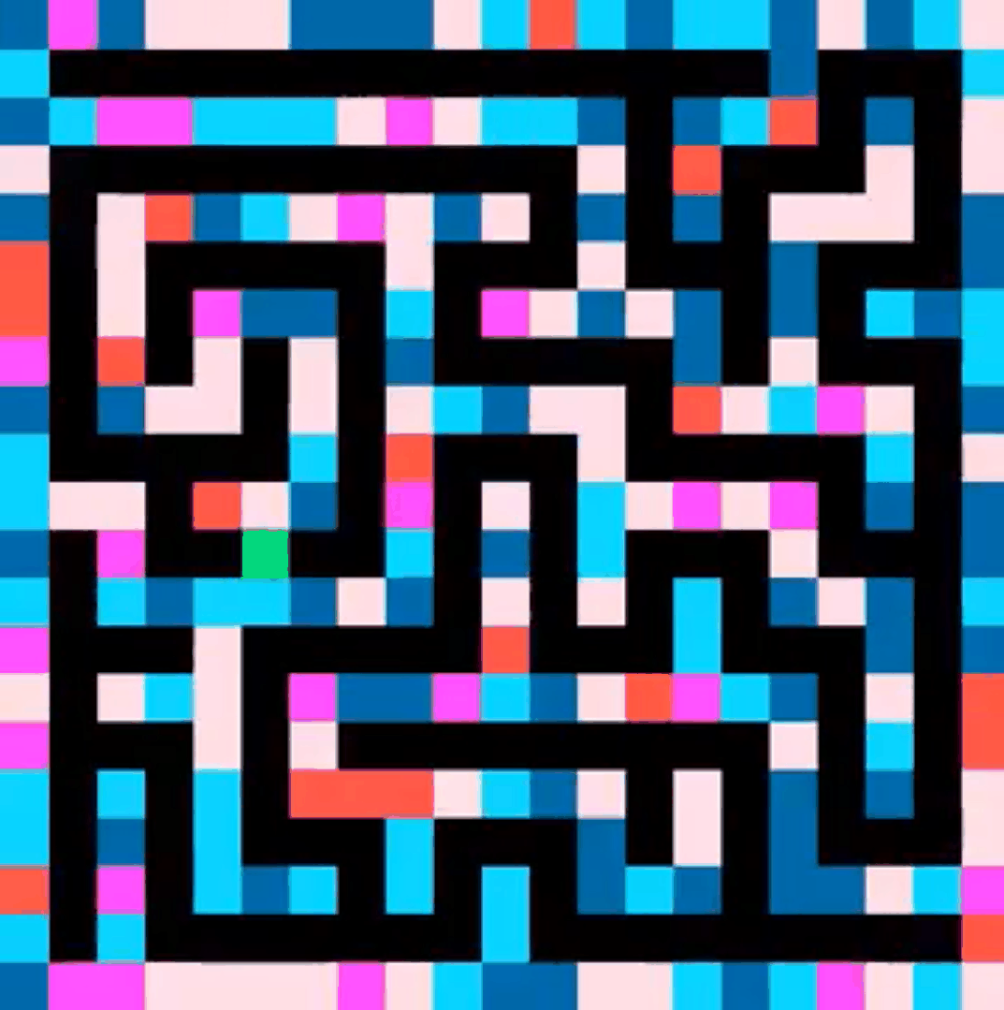
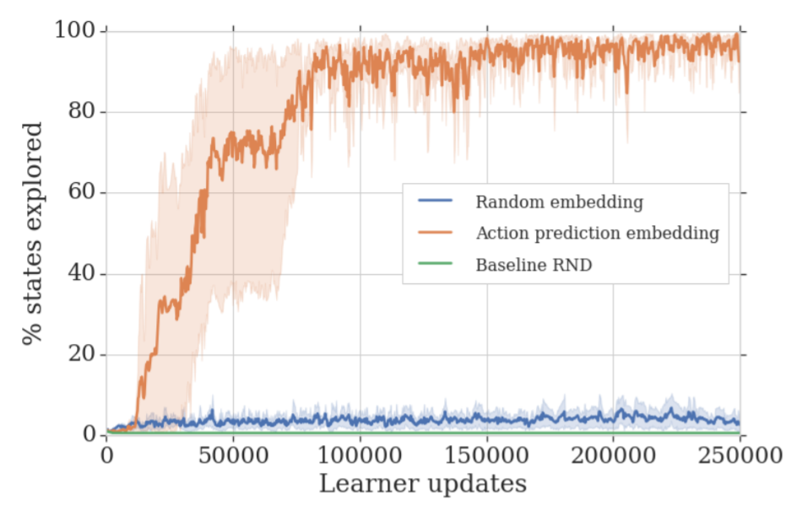
Experiments
Random Disco Maze
Things to check
Effectiveness of the purely exploratory policy
Effectiveness of the controllable state representation
Black – pathways, Green – agent
Random - wall

Slide 19
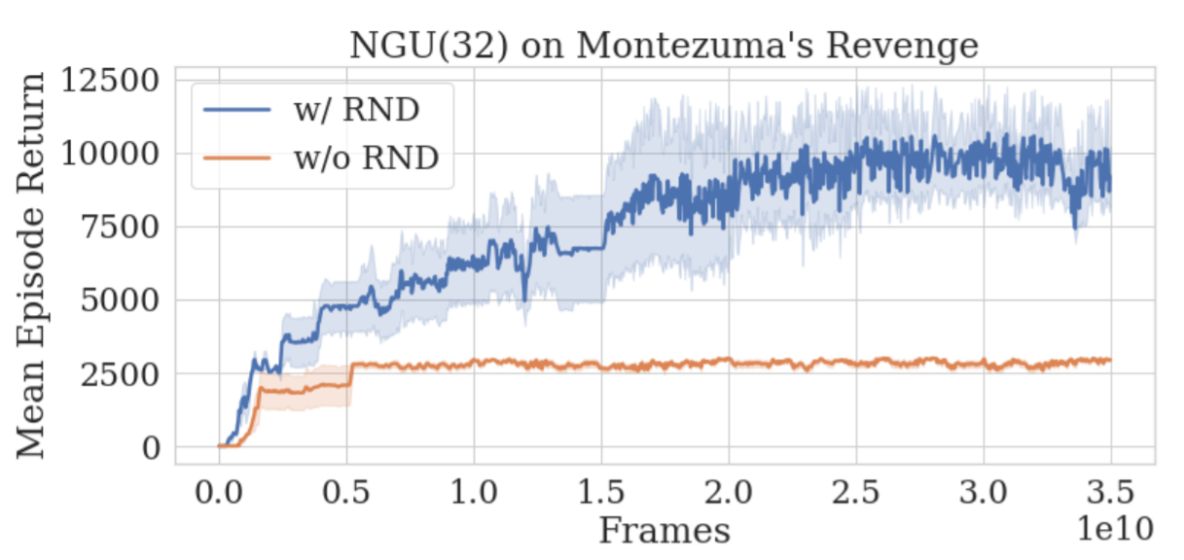
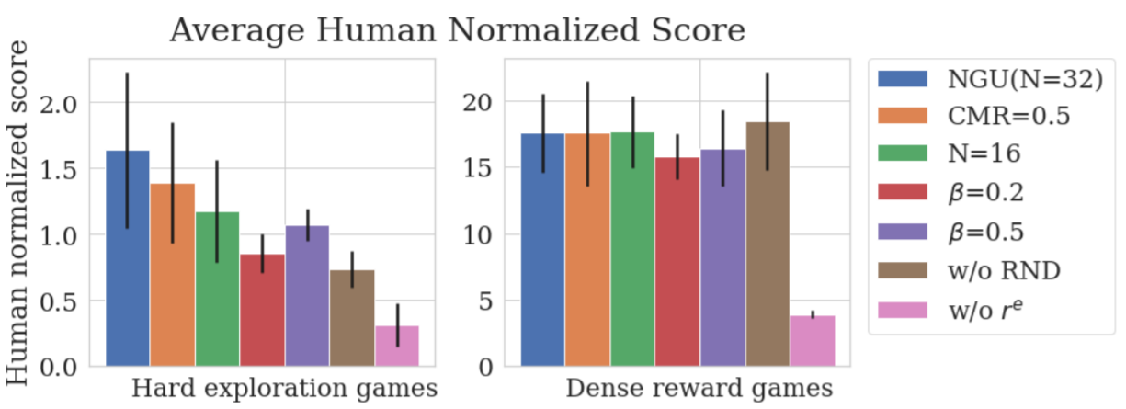
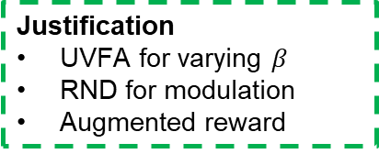
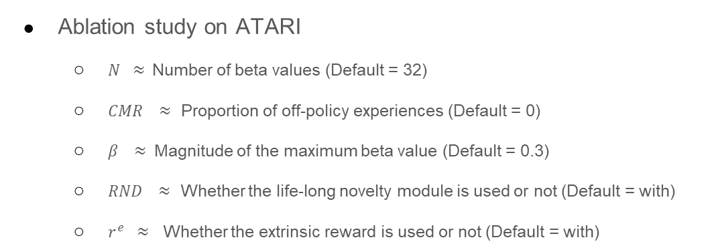
Experiments
Ablation study on ATARI
$N ≈$Number of beta values (Default = 32)
$CMR ≈$ Proportion of off-policy experiences (Default = 0)
$β ≈$Magnitude of the maximum beta value (Default = 0.3)
$RND ≈$ Whether the life-long novelty module is used or not (Default = with)
$r^{e} ≈$ Whether the extrinsic reward is used or not (Default = with)
Justification
UVFA for varying $β$
RND for modulation
Augmented reward

Slide 20
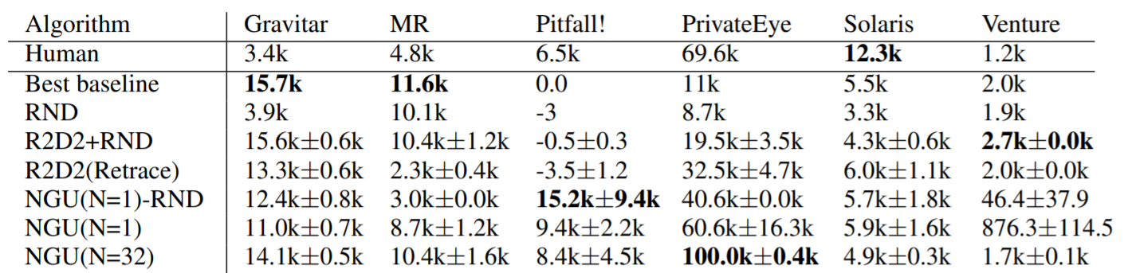
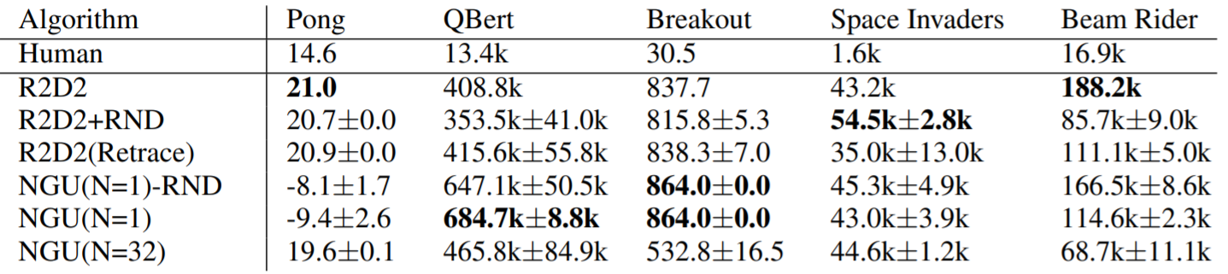
Experiments
Comparing to several baselines
Hard
Exploration
Games
Dense
Reward
Games

Slide 21
Conclusion

Slide 22
Conclusion
Summary
Designing the intrinsic rewards to encourage the agents to visit diverse states within and across episodes
(Embedding function, Episodic Novelty Module, Life-long Novelty Module)
Learn a range of policies with varying the exploration and exploitation trade-offs
(UVFA framework)
Extension
Agent 57 : Outperforming the Atari human benchmark
(https://arxiv.org/abs/2003.13350)
Utilizing the meta controller to choose which beta to be utilized for each episode

Slide 23
Thank you for your attention

Slide 24
Appendix

Slide 25
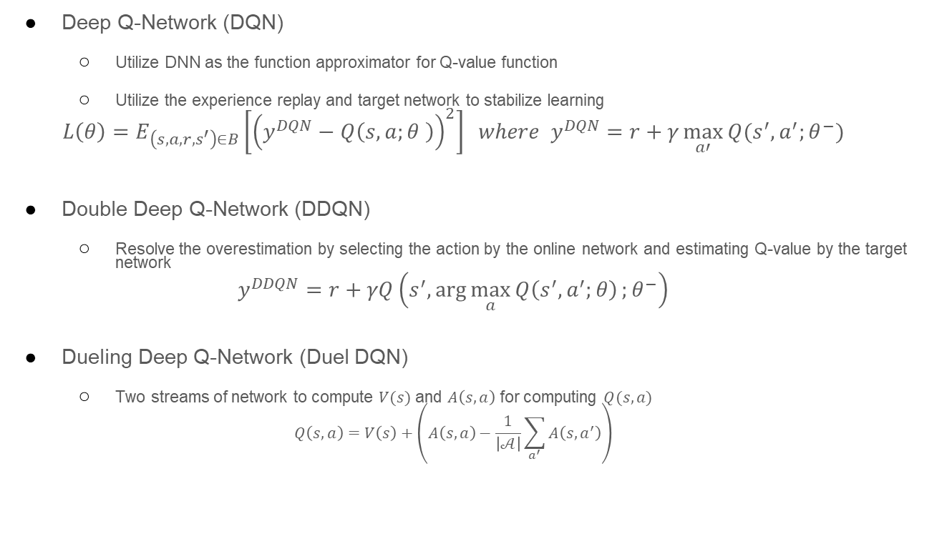
DQN variants
Deep Q-Network (DQN)
Utilize DNN as the function approximator for Q-value function
Utilize the experience replay and target network to stabilize learning
$$L\left(θ\right)=E_{\left(s,a,r,s^{′}\right)∈B}\left[{\left(y^{DQN}−Q\left(s,a;θ \right)\right)}^{2}\right] where y^{DQN}=r+γ\max_{a′}{Q(s^{′},a^{′};θ^{−})}$$
Double Deep Q-Network (DDQN)
Resolve the overestimation by selecting the action by the online network and estimating Q-value by the target network
$$y^{DDQN}=r+γQ\left(s^{′},\arg{\max_{a}{Q\left(s^{′},a^{′};θ\right)}};θ^{−}\right)$$
Dueling Deep Q-Network (Duel DQN)
Two streams of network to compute $V(s)$ and $A\left(s,a\right)$ for computing $Q(s,a)$
$$Q\left(s,a\right)=V\left(s\right)+\left(A\left(s,a\right)−\frac{1}{\left|𝒜\right|}\sum_{a^{′}}{A\left(s,a^{′}\right)}\right)$$

Slide 26
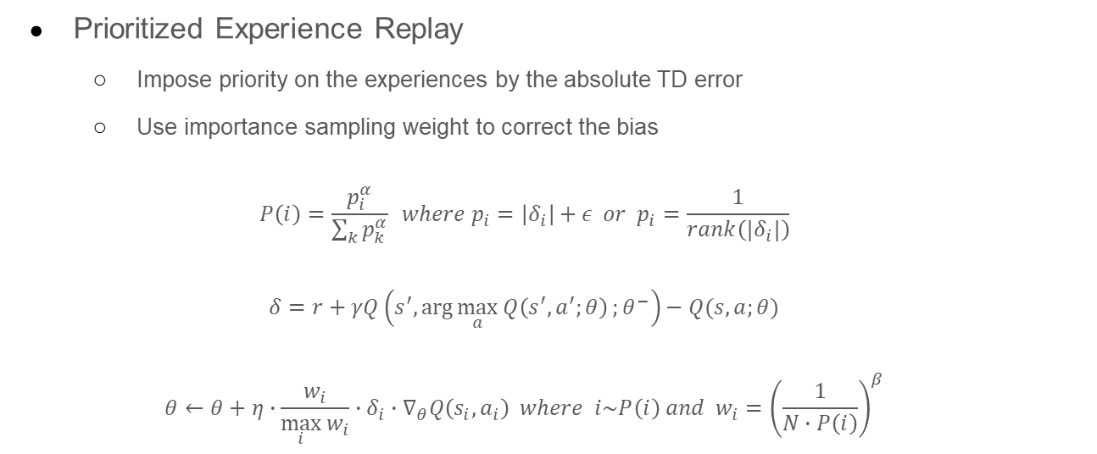
Sampling with Priority
Prioritized Experience Replay
Impose priority on the experiences by the absolute TD error
Use importance sampling weight to correct the bias
$$P\left(i\right)=\frac{p_{i}^{α}}{\sum_{k}{p_{k}^{α}}} where p_{i}=\left|δ_{i}\right|+ε or p_{i}=\frac{1}{rank\left(|δ_{i}|\right)}$$
$$δ=r+γQ\left(s^{′},\arg{\max_{a}{Q\left(s^{′},a^{′};θ\right)}};θ^{−}\right)−Q(s,a;θ)$$
$$θ←θ+η∙\frac{w_{i}}{\max_{i}{w_{i}}}∙δ_{i}∙∇_{θ}Q\left(s_{i},a_{i}\right) where i\sim P\left(i\right) and w_{i}={\left(\frac{1}{N∙P\left(i\right)}\right)}^{β}$$

Slide 27
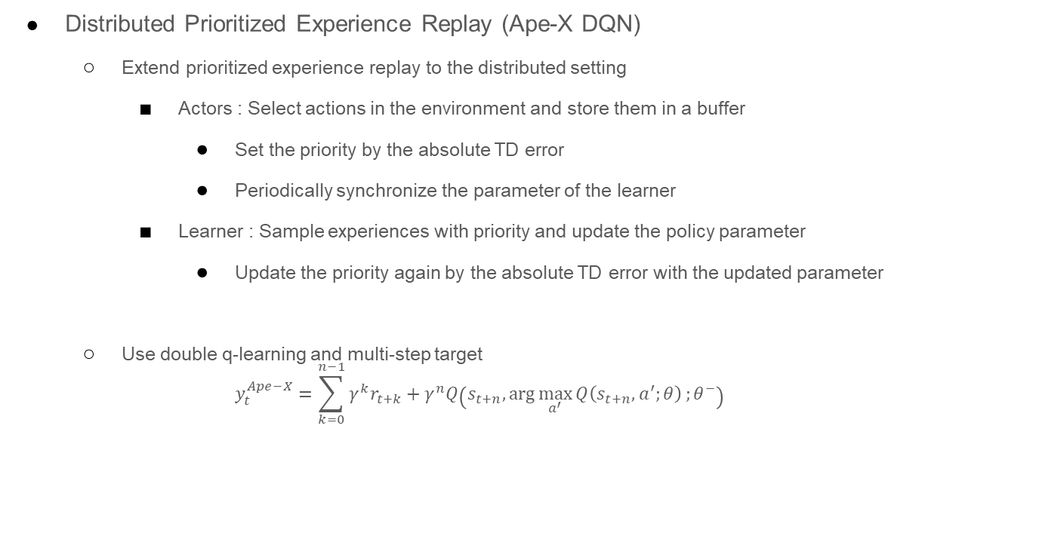
(continued)
Distributed Prioritized Experience Replay (Ape-X DQN)
Extend prioritized experience replay to the distributed setting
Actors : Select actions in the environment and store them in a buffer
Set the priority by the absolute TD error
Periodically synchronize the parameter of the learner
Learner : Sample experiences with priority and update the policy parameter
Update the priority again by the absolute TD error with the updated parameter
Use double q-learning and multi-step target
$$y_{t}^{Ape−X}=\sum_{k=0}^{n−1}{γ^{k}r_{t+k}}+γ^{n}Q\left(s_{t+n},\arg{\max_{a^{′}}{Q\left(s_{t+n},a^{′};θ\right)}};θ^{−}\right)$$

Slide 28
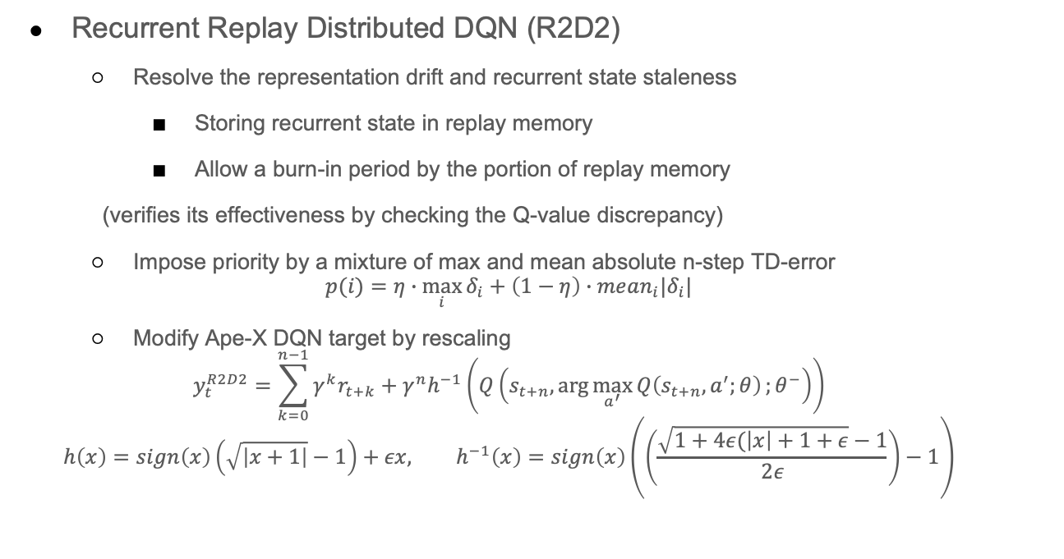
Recurrent Replay Distributed DQN
Recurrent Replay Distributed DQN (R2D2)
Resolve the representation drift and recurrent state staleness
Storing recurrent state in replay memory
Allow a burn-in period by the portion of replay memory
(verifies its effectiveness by checking the Q-value discrepancy)
Impose priority by a mixture of max and mean absolute n-step TD-error
$$p(i)=η∙\max_{i}{δ_{i}}+\left(1−η\right)∙mean_{i}|δ_{i}|$$
Modify Ape-X DQN target by rescaling
$$y_{t}^{R2D2}=\sum_{k=0}^{n−1}{γ^{k}r_{t+k}}+γ^{n}h^{−1}\left(Q\left(s_{t+n},\arg{\max_{a^{′}}{Q\left(s_{t+n},a^{′};θ\right)}};θ^{−}\right)\right)$$
$$h\left(x\right)=sign\left(x\right)\left(\sqrt{\left|x+1\right|}−1\right)+εx, h^{−1}\left(x\right)=sign\left(x\right)\left(\left(\frac{\sqrt{1+4ε(\left|x\right|+1+ε}−1}{2ε}\right)−1\right)$$

